Slide 1

Apex Institute of Technology
Department of Computer Science & Engineering
Bachelor of Engineering (Computer Science & Engineering)
Design and Analysis of Algorithms– (21CSH-282)
Prepared By: Mr. Vikas Kumar (E13657)
DISCOVER . LEARN . EMPOWER

Slide 2
Content
Searching: Linear Search
Binary Search.

Slide 3
Linear Search
Linear search is a straightforward method of searching.
It is sometimes referred to as a sequential search.
Assume A is an n-dimensional array. We wish to find an element in this array. This element will be referred to as a ‘Key.’
The Key is compared to each element of the array A one by one until the Key is discovered. The algorithm stops in two cases:
when a key element is discovered or
when the whole array is searched.

Slide 4
Algorithm of Linear Search
Algorithm LINEAR_SEARCH(A, Key)
// Description: Perform a linear search on array A to search element Key
// Input: Array of length n and Key to be searched
// Output: Success/failure message
flag ← 0
for i ← 1 to n do
if Key == A[i] then
print “Element Found on Location”, i
flag ← 1
break
end
end
if flag == 0 then
print “Element Not Found”
end

Slide 5
Complexity
Best Case:
If the key element is discovered in the first location, the algorithm just needs one comparison. A number of comparisons should be independent of array size in the best scenario. If the key is at the first place of the array, the method does one comparison regardless of the length of the array. As a result, the best-case running time for linear searching is T(n) = O(1).
Worst Case:
If the key element is at the last place or is not there at all, the algorithm performs the maximum number of comparisons. The array as a whole must be scanned. The number of comparisons grows linearly with the size of the array. As a result, the worst-case running time of the linear search is T(n) = O(n).
The problem size is reduced by one on each iteration, and the method does one comparison. So recurrence for linear search can be defined as T(n) = T(n – 1) + 1. The solution to this recurrence also demonstrates that the linear search’s worst-case running time is O(n).

Slide 6
Complexity
Average Case:
The average case occurs when an element is neither at the first location nor at the last. The key element may be near the beginning of the array or maybe near to end, or it may be somewhere near the middle. On average, the algorithm does (n / 2) comparisons.
Thus, T (n) = O(n/2) = O(n)

Slide 7
Recurrence Equation:
Let us solve the recurrence:
In every iteration, the algorithm does one comparison and the problem size is reduced by 1. Hence, the recurrence of linear search can be formulated as,
T(n) = 0, for n = 0
T(n) = T(n – 1) + 1, for n > 0

Slide 8
Recurrence Equation:
T(n – 1) = T(n – 2) + 1
⇒ T(n) = [T(n – 2) + 1] + 1 = T(n – 2) + 2
T(n – 2) = T(n – 3) + 1
⇒ T(n) = [T(n – 3) + 1] + 2 = T(n – 3) + 3
After k iterations,
T(n) = T(n – k) + k
For k = n
T(n) = T(n – n) + n = T(0) + n
The cost of solving problem of size 0 is definitely 0, so T(0) = 0
Hence, T(n) = O(n)

Slide 9
Example:
Simulate the linear search algorithm on an array A {44, 22, 88, 11, 55, 33, 66, 77} with Key = 55.
Here, the element to be searched is 55, so Key = 55.
Linear search scans the array one by one element and compares it with the h Key. If the Key is found, the search stops, otherwise, it scans the next element and compares it with the key.

Slide 10
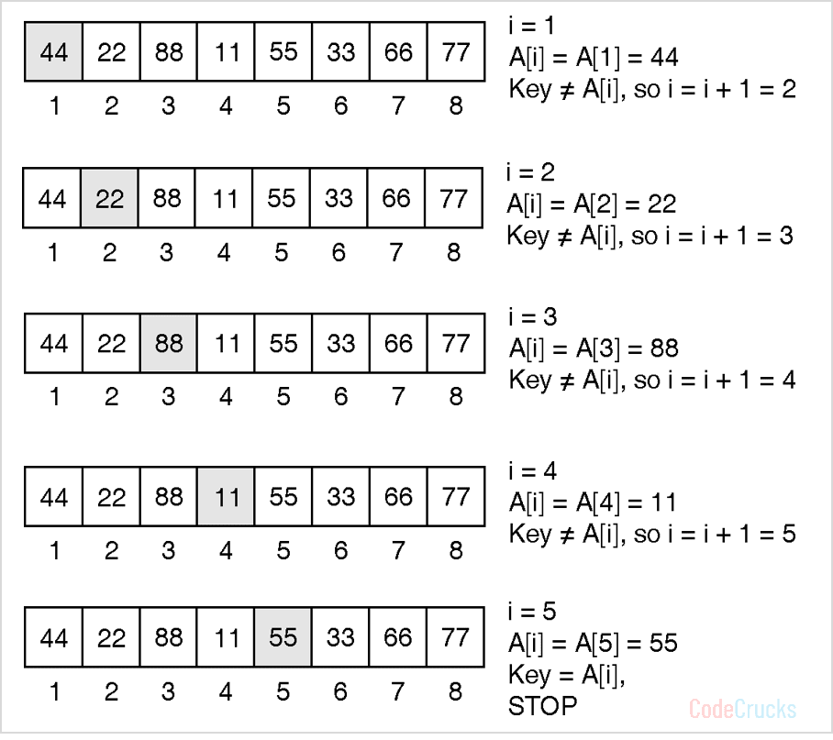
Example:

Slide 11
Binary Search
The binary search method is more efficient than the linear search method.
The array must be sorted for binary search, which is not necessary for linear search.
Binary search is a search strategy based on divide and conquer.
The method divides the list into two halves at each step and checks whether the element to be searched is on the top or lower side of the array.
If the element is located in the center, the algorithm returns.

Slide 12
Binary Search
Let us assign the minimum and maximum index of the array to variables low and high, respectively. The middle index is computed as (low + high)/2.
In every iteration, the algorithm compares the middle element of the array with a key to be searched. The initial range of search is A[0] to A[n – 1]. When the key is compared with A [mid], there are three possibilities :
The array is already sorted, so if key < A[mid] then the key cannot be present in the bottom half of the array. The search space of the problem will be reduced by setting the high index to (mid – 1). The new search range would be A[low] to A[mid – 1].
If key > A[mid] then the key cannot be present in the upper half of the array. The search space of the problem will be reduced by moving the low index to (mid + 1). The new search range would be A[mid + 1] to A[high].
If key = A[mid], the search is successful, and the algorithm halts.
This process is repeated till the index low is less than the high or the element is found.

Slide 13
Algorithm for Binary Search
Algorithm BINARY_SEARCH(A, Key)
// Description : Perform a binary search on array A
// Input : Sorted array A of size n and Key to be searched
// Output : Success / Failure
low ← 1
high ← n
while low < high do
mid ← (low + high) / 2
if A[mid] == key then
return mid
else if A[mid] < key then
low ← mid + 1
else
high ← mid – 1
end
end
return 0
Binary search reduces search space by half in every iteration. In a linear search, the search space was reduced by one only.
If there are n elements in an array, binary search, and linear search have to search among (n / 2) and (n – 1) elements respectively in the second iteration.
In the third iteration, the binary search has to scan only (n / 4) elements, whereas the linear search has to scan (n – 2) elements.
This shows that a binary search would hit the bottom very quickly.

Slide 14
Complexity Analysis of Binary Search
Best Case:
In binary search, the key is initially compared to the array’s middle element. If the key is in the center of the array, the algorithm only does one comparison. As a result, the algorithm’s best-case running time is T(n) = 1.
Worst Case:
In every iteration, the binary search space is decreased by half, allowing for maximum log2n array divisions.
If the key is at the leaf of the tree or it is not present at all, then the algorithm does log2n comparisons, which is the maximum.
The number of comparisons increases in logarithmic proportion to the amount of the input. As a result, the algorithm’s worst-case running time would be T(n) = O(log2 n).
The problem size is reduced by a factor of two after each iteration, and the method does one comparison. Recurrence of binary search can be written as T(n) = T(n/2) + 1.
The solution to this recurrence leads to the same running time, i.e. O(log2n).

Slide 15
Recurrence Equation:
T (n) = T(n/2) + 1 …(1)
Substitute n by n/2 in Equation (1) to find T(n/2)
T(n/2) = T(n/4) + 1 …(2)
Substitute value of T(n/2) in Equation (1),
T(n) = T(n/2²) + 1 …(3)
Substitute n by n/2 in Equation (2) to find T(n/4),
T(n/4) = T(n/8) + 1
Substitute value of T(n/4) in Equation (3),
T(n) = T(n/2³) + 3

Slide 16
Recurrence Equation:
After k iterations,
T(n) = T(n^{k}) + k
Binary tree created by binary search can have maximum height log2n
So, k = log2n ⇒ n = 2^{k}
T(n) = T(2^{k}/2^{k}) + k
= T(1) + k
From base case of recurrence,
T(n) = 1 + k = 1 + log2n
T(n) = O(log2n)

Slide 17
Complexity Analysis of Binary Search
Average Case:
The average case for binary search occurs when the key element is neither in the middle nor at the leaf level of the search tree.
On average, it does half of the log2 n comparisons, which will turn out as
T (n) = O(log2 n).

Slide 18
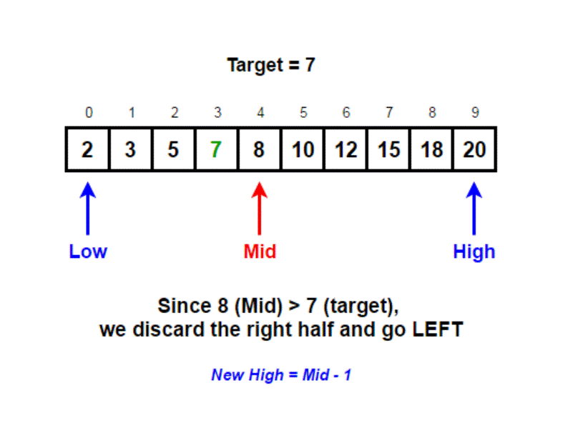
Example
nums = [2, 3, 5, 7, 8, 10, 12, 15, 18, 20]
target = 7

Slide 19
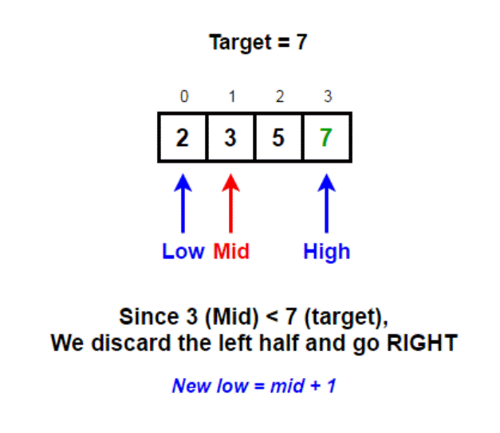
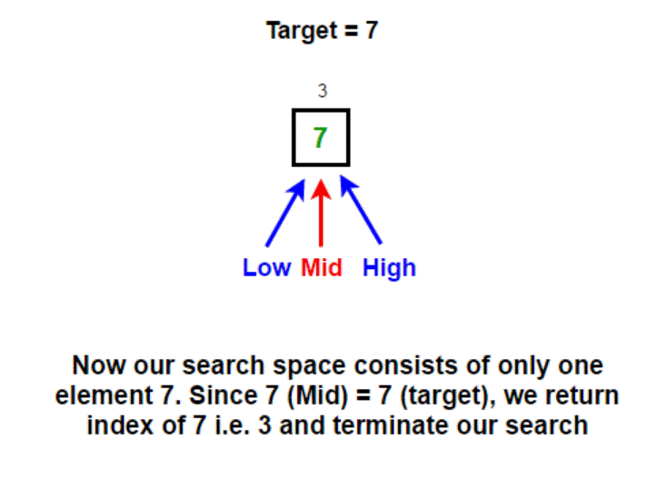
Example

Slide 20
TASKS END OF LECTURE LEARNING (TELL):
Task 1:
Simulate the linear search algorithm on an array A {44, 22, 88, 11, 55, 33, 66, 77} with Key = 66.
Task 2:
Given a sorted array containing duplicates, efficiently find each element’s frequency without traversing the whole array Linear Search.
Task 3:
Given a positive number, return the square root of it. If the number is not a perfect square, return the floor of its square root.
Task 4:
Implement a ternary search algorithm and compare its performance with a binary search algorithm.
Task 5:
Simulate the Binary search algorithm on an array A {44, 22, 88, 11, 55, 33, 66, 77} with Key = 66.

Slide 21
References
Fundamentals of Computer Algorithms 2nd Edition (2008) by Horowitz, Sahni and Rajasekaran
Introduction to Algorithms 3rd Edition (2012) by Thomas H Cormen, Charles E Lieserson, Ronald

Slide 22
THANK YOU
For queries
Email: vikash.e13657@cumail.in

